Slide 1



Day 04
contact@anubhavtrainings.com
ABAP RESTFUL APPLICATION PROGRAMMING

Slide 2

Agenda – Day 04
Managed Implementation – Demo Scenario
Projections
Flexible service consumption
Development flow – managed scenario
Implementation for processor scenario
Final processor Fiori App
Recap and Testing Composition
Implementing the Action createTravelByTemplate
Implementing the Action approveTravel
Implementing the Action rejectTravel
Modeling Static and Dynamic Feature Control
Implementing Validations
Implementing the Determination

Slide 3
Calculator
3rd – 6th
Addition, subtraction
Calculator
7 and above
Addition, multiplication, division
1 2 3
4 5 6
7 8 9
0 $
1 2 3
4 5 6
7 8 9
0 $
+
/
+
-
*
Projection
Projection
1 2 3
4 5 6
7 8 9
0 $
/
+
*
-

Slide 4


Our Demo Scenario
This demo scenario uses two projections with a different service scope. The resulting apps represent two role-based approaches to managing travels.
One business object projection uses the BO characteristics and the operations that are relevant for processing travel data. This resulting UI service serves the role of a data processor. The responsible person can enter the information about travels, bookings into the role-based app for processing travel data. This person needs functionality to create, update and delete entries on all three tiers of the business object. In addition, the action CreateByTravelTemplate is designed to facilitate the creation of new travel entries. The instance-bound action reads the values of the selected entry and creates a new entry based on these values with some deviations for the TravelID and the travel dates.
The other business object projection is the basis for a UI service that contains the functionality that is relevant for an approver. Imagine a person, maybe a manager of a travel agency, that approves the data that was entered by the processor. That means, this person sees the travel information and the corresponding booking data. Based on this data, the approver can either accept or reject the travel. For a minimal scope of fields in the travel entity the approver is enabled to edit the values, for example the BookingFee or the Description. The information about bookings is set to read-only for the approver. The approver is not allowed to change the fields of the booking entity.
Processor
Approver

Slide 5
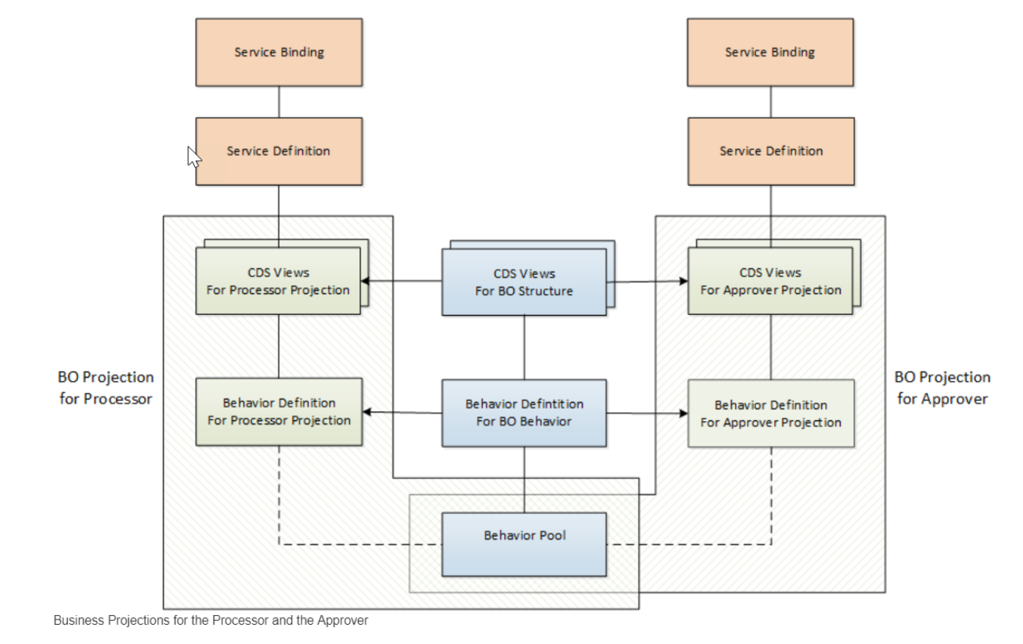
Projections

Slide 6
Introduction – Flexible Service Consumption
For a more flexible service consumption, every transactional business object is projected into a service specific context. In other words, only those elements of the data model and those behavior characteristics and operations that are needed in the relevant business service context are exposed for the service.
By means of projections, you can expose one BO in different business contexts by using different BO subsets. The general business logic is defined in the BO whereas the BO projection adopts a subset of the business logic.
A layering with projections enables robust application programming. You can change or enhance the BO without changing the exposed service as the scope of the service is defined in the projection layer. Enhancing the business object with additional structure or behavior does not have any effect on the resulting service.

Slide 7
Development Flow
4. Imp Behavior Definition on top of Projection View’s of Processor App.
7. Imp Behavior Definition on top of Projection View’s of Approver App.
2. Imp Behavior Definition on Travel.
6. Create Service Binding on top of Service Definition.
10. Create Service Binding on top of Service Definition .
1
3
5
7
9
2
4
6
8
10
1. Create Basic CDS View’s
For Travel & Booking.
3. Create Projection CDS on top of Basic View’s for Processor App.
5. Create Service Definition for Processor App.
7. Create Projection CDS on top of Basic View’s for Approver App.
9. Create Service Definition for Approver App.

Slide 8
Lose coupling
Both entities can co-exist w/o each other
Good to have relation
Tight Coupling
They come together
Must have relation

Slide 9
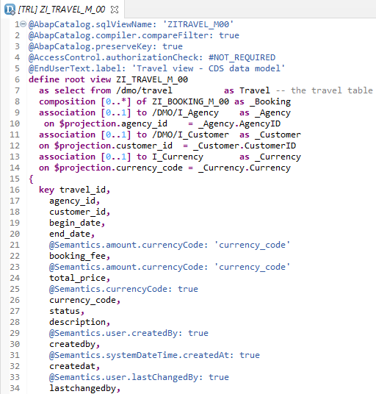
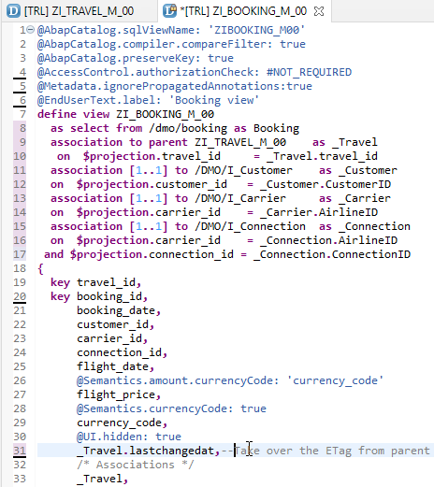
Create Base CDS View
ZI_TRAVEL_M_00
ZI_BOOKING_M_00

Slide 10
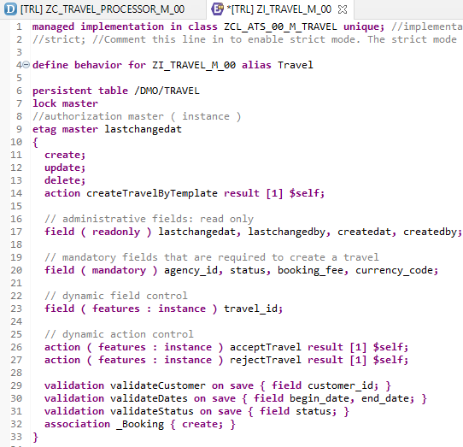
Implementing Base Behavior Definition
In the Project Explorer view of your ABAP project (or ABAP Cloud Project), select the node for the data definition that defines the root entity ZI_TRAVEL_M_XX. Open the context menu and choose New Behavior Definition to launch the behavior definition creation wizard.
“ZI_TRAVEL_M_00”
Behavior Definition for Base CDS’s Views .

Slide 11
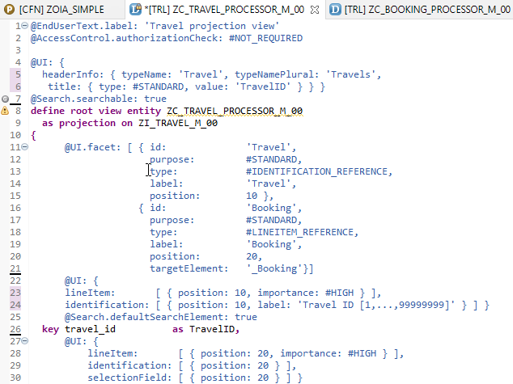
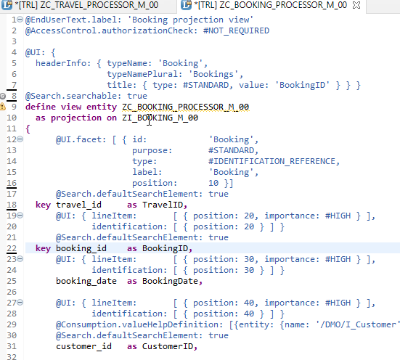
Projection CDS View’s for Processor
Projection CDS View for Travel Info “ZC_TRAVEL_PROCESSOR_M_00”
Projection CDS View for Booking Info “ZC_BOOKING_PROCESSOR_M_00”

Slide 12
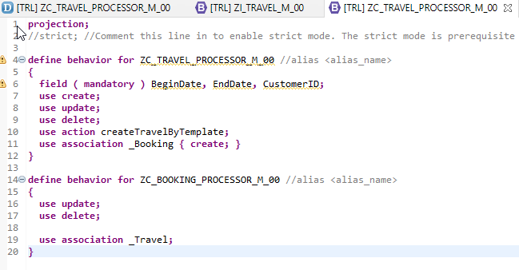
Behaviour Definition for Processor
The behavior for the BO projection is defined in a behavior definition of type projection. The type is defined in the behavior definition header. The projection behavior definition provides the behavior for the projection CDS view. All characteristics and operations that you want to include in the BO projection must be listed explicitly
“ZC_TRAVEL_PROCESSOR_M_00”
Behavior Definition for Projection CDS’s Views of Processor.

Slide 13
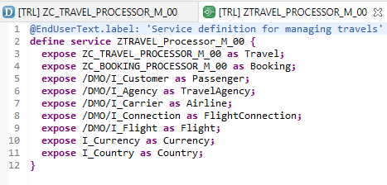
Service Definition
The service definition is a projection of the models and related behavior that you want to expose. In a service definition, you define the OData service to determine which CDS entities are part of the service. This service is then bound to a protocol and to either a UI technology or an A2X service by a service binding artifact. A service definition can be integrated in various protocols without any reimplementation.
Exercise
“ZTRAVEL_PROCESSOR_M_00”
Service Definition for Expose Entity

Slide 14
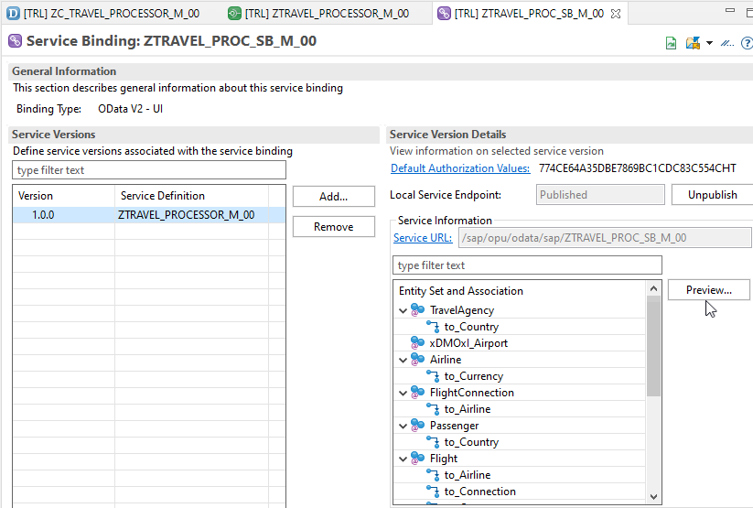
Service Binding (OData)
A service binding implements the protocol that is used for the OData service. It uses a service definition that projects the data models and their related behaviors to the service.
After Creating Service Binding , Select Entity and Click on Preview

Slide 15
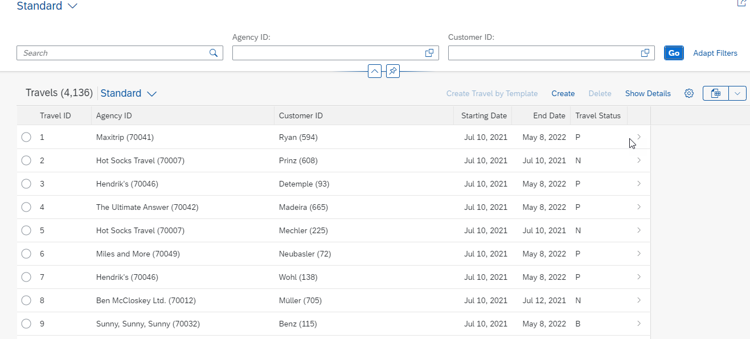
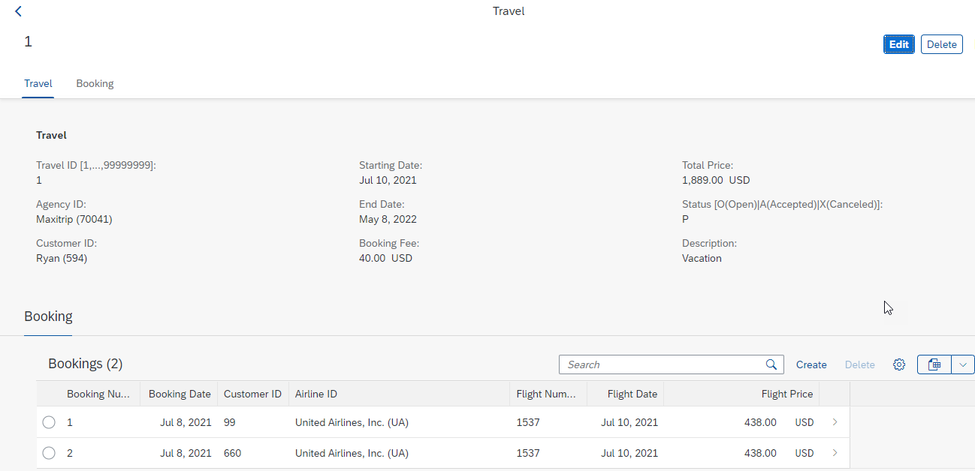
Final Result of Processor App
1st Screen with Search Bar & Filter Bar
2nd Screen with Travel and Booking Data,
& C-R-U-D Functionality

Slide 16
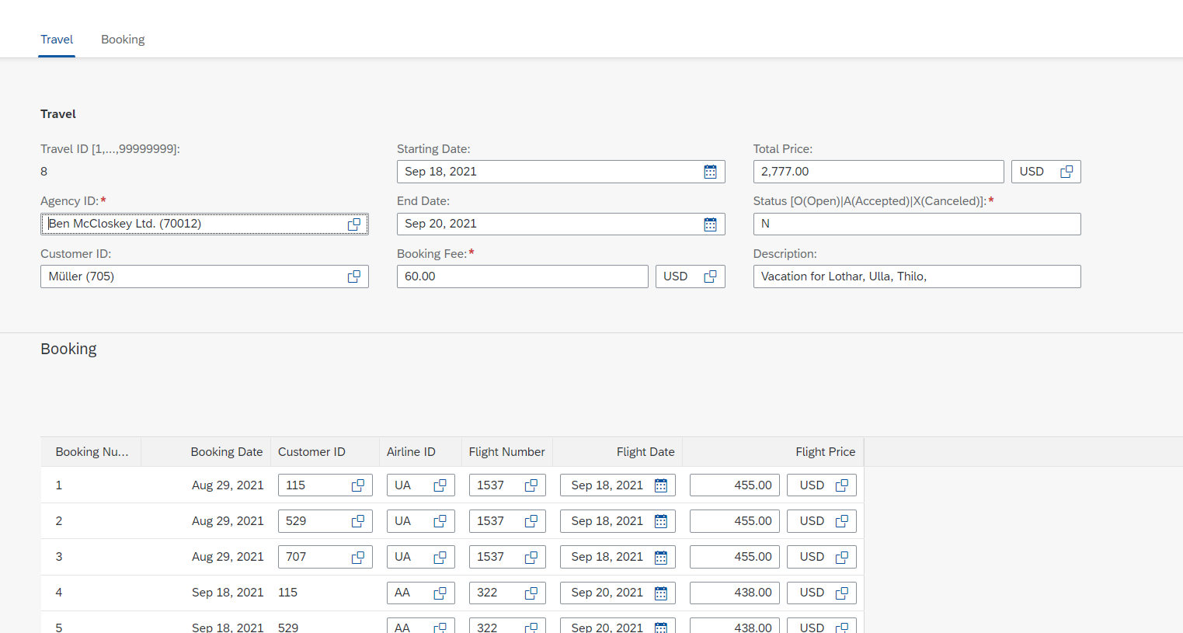
Testing composition
We should be able to create Travel request with bookings.

Slide 17
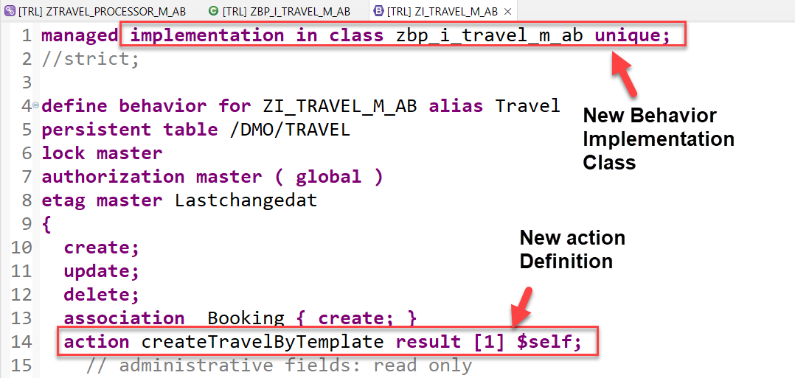
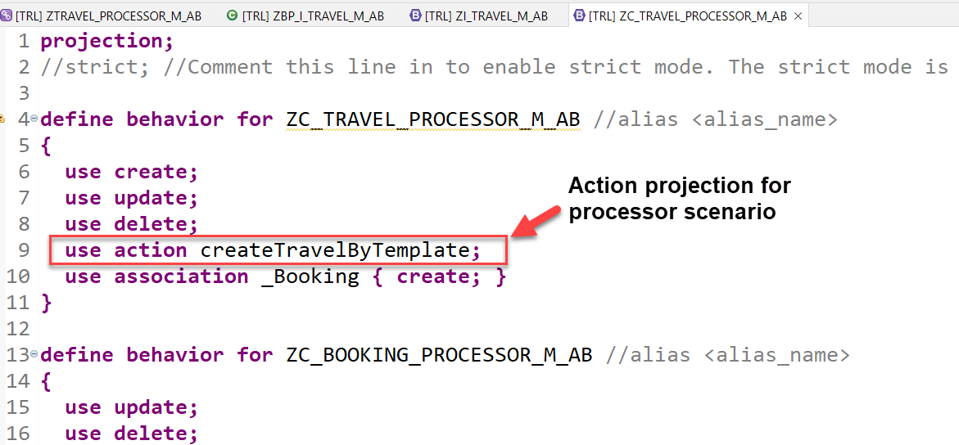
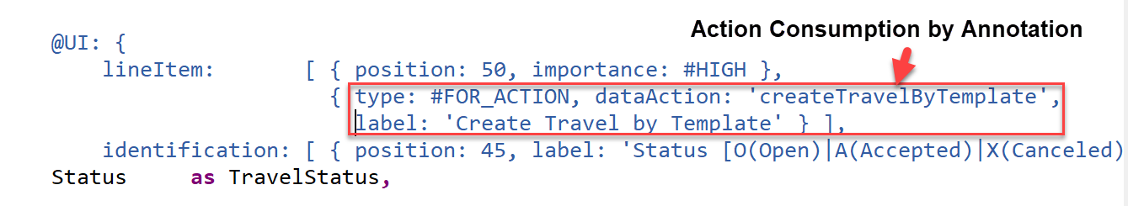
Implementing Action “createTravelByTemplate”
This action provides a template for creating a new travel based on an already existing travel instance.
Exercise
Create Travel By Template Action Code

Slide 18
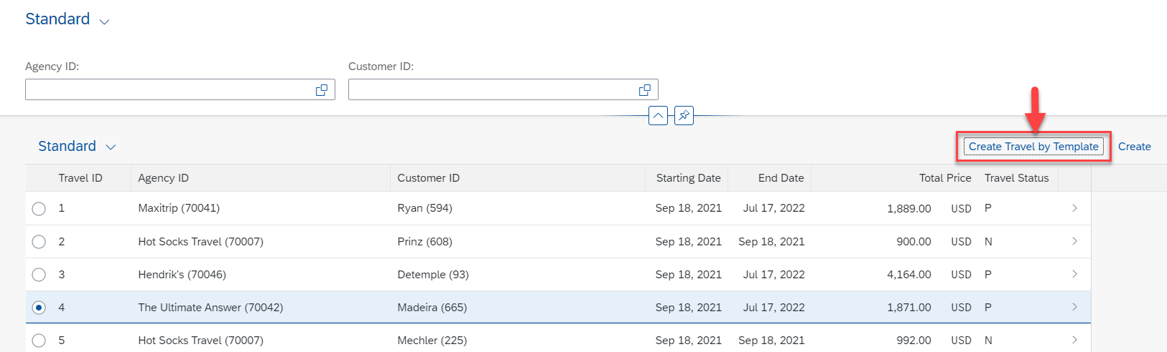
Result of Action Implementation
Check how the UI of a Fiori application looks like or refresh the browser where Fiori app is displayed.

Slide 19
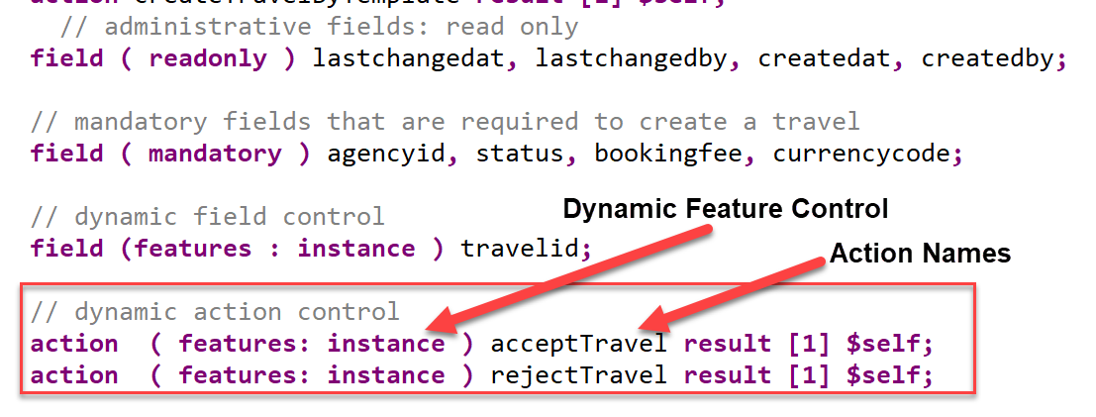
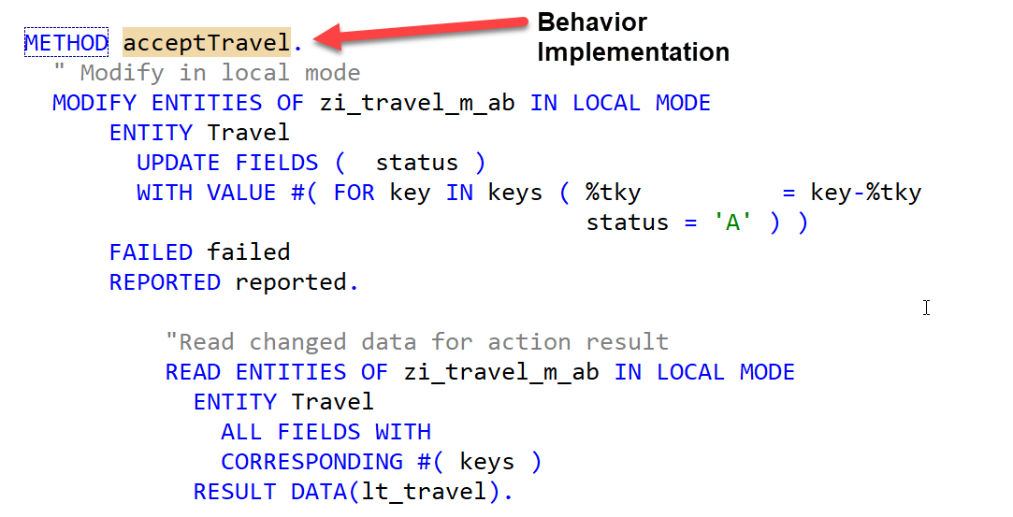
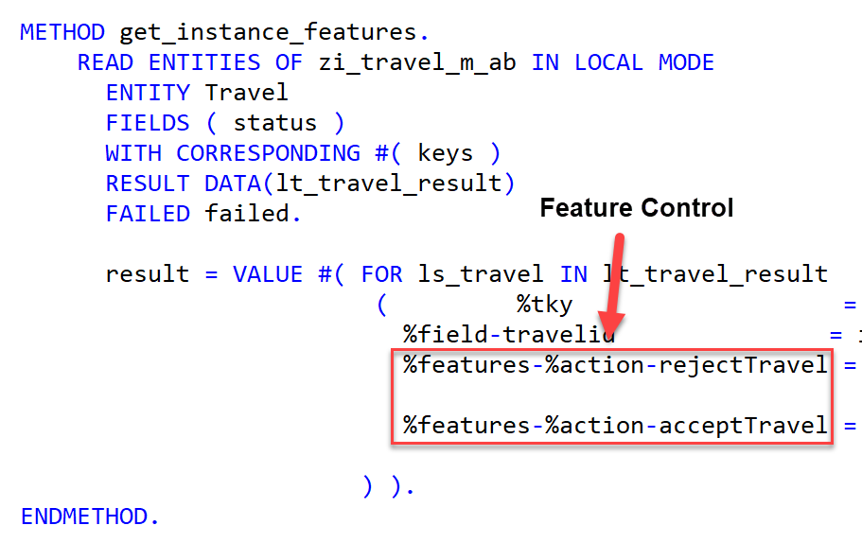
Implementing Action “approve/rejectTravel”
These 2 actions are going to be used later in approver scenario and also have dynamic feature control
Exercise
Approve/Reject Action Code

Slide 20
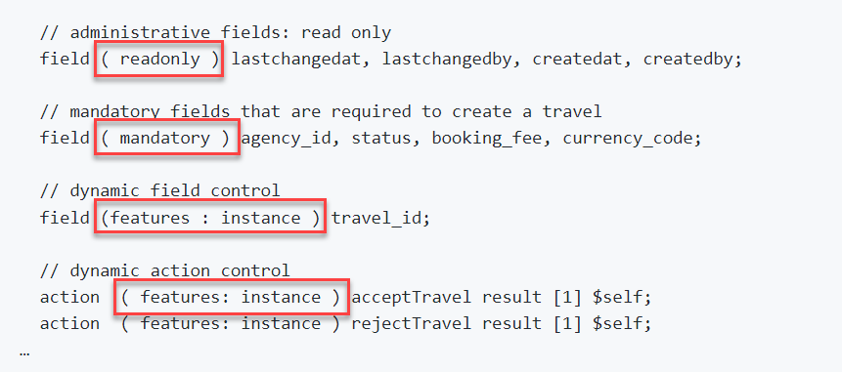
Modeling Static and Dynamic Feature Control
As an application developer you may want to determine, which entities of your business object should be create-, delete- and update-enabled, so that they can be modified during consumption using EML or OData services. In addition, you also may want control which (UI) fields of an entity are read-only or which actions in which usage scenarios are enabled or disabled for execution by the end users.
In ABAP RESTful programming model, the feature control is precisely the means of accomplishing such tasks. It allows you to control the visibility and changeability of fields, operations or entire entities.
Depending on whether feature control refers to specific instances or is independent of each entity instance, we distinguish between instance-bound and static feature control.
The availability of feature control values is modelled in a behavior definition. Unlike static, instance-bound feature control requires not only a definition but also an implementation in a handler class of the behavior pool. Therefore, we also talk about dynamic feature control in case of instance-bound feature control.
Both, static and dynamic feature control is defined for different levels (entity, field, or action level) in the behavior definition by using the following syntax:
Exercise
Dynamic Feature Control Code

Slide 21
Requirements
Make Administrative fields for Travel as Read Only
Make Travel Fields Mandatory for booking
Control the Accept and Reject Travel actions based on status
Make Connection fields mandatory for Booking
Control the Customer ID field based on Carrier, For AA make it Read only

Slide 22
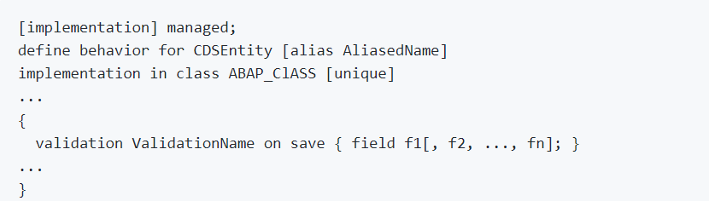
Implementing Validations
A validation is an implicitly executed function intended to check the data consistency of an existing instance of an entity (consistency validation). It is implicitly invoked by the business object’s framework as soon as a trigger condition at a predefined point in time is fulfilled. Validation can return messages to the consumer and reject inconsistent instance data from being saved.
Validations never modify any instance data but return the messages and keys of failed (inconsistent) entity instances.
Validations are specified for individual business object’s entities in the behavior definition by using the following syntax:

Slide 23
F1
F2 1 → 2
F3
Save
If f1 is not initial
If f2 is not initial
select * checktable where exist f2
If f3 is not initial
check itab has f3

Slide 24
Use case for Validation
Check if the customer ID referenced in the Travel order is valid.
Check if the travel end date is more than Travel Start Date
Check if the status passed by User is valid.
These validations are assigned to the "Travel" entity having defined update as the trigger operation on entity "Travel". As soon as data is updated by the consumer, the validation will check it and return a warning message if the unusual condition arrives.
Exercise
Validation Code

Slide 25
Implementing the Determination
A determination is an implicitly executed function that handles side effects of modified entity instances. It is invoked by the business object’s framework as soon as a determination’s trigger condition at a predefined point in time, the determination time, is fulfilled.
Determinations are triggered internally based on changes made to the entity instance of a business object. The trigger conditions are checked by business object framework at different points during the transaction cycle, depending on the determination time and the changing operations on the relevant entity instances. For each determination, it is necessary to specify both the determination time and the changes that form the trigger condition. A trigger condition consists of a list of fields belonging to the same entity the determination is assigned to and the changing operations that include creating or updating entity instances. We call this operations trigger operations.
In case a field is changed (after creation or update), the condition is fulfilled. The framework evaluates the triggering condition of all determinations at certain points in time (determination time). For determinations, this is today either after each modification or during the save phase.
You can use a determination primarily to compute data that is derived from the values of other fields. The determined fields and the determining fields either belong to the same entity or to different entities of a business object.
As a result, determination can modify entity instances and return transition messages (error, warning, information, success).

Slide 26
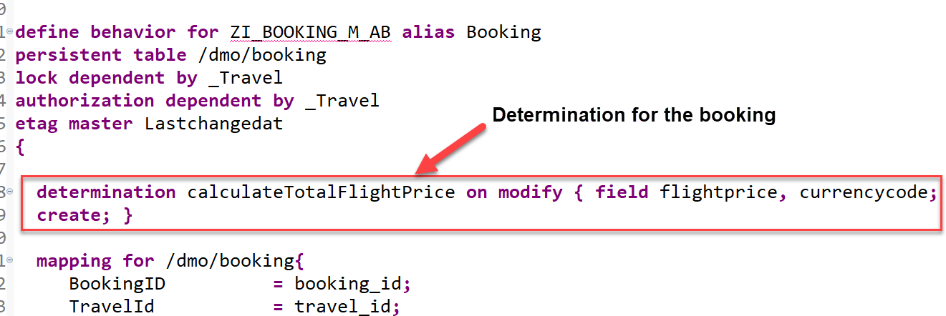
Implementing the Determination
The determination calculateTotalFlightPrice on the booking entity is intended to handle the calculation of total price of all flight bookings that belong to the selected travel.
The determination will be triggered by on modify as determination time when creating new booking instances or updating the flight price value or when changing the currency. In other words: both fields flight_price and currency_code serve as trigger fields and form together with create and update operations the trigger condition for the determination.

Slide 27

End of Day 04
Trainer: Anubhav Oberoy

Slide 28
Trainer: Anubhav Oberoy

Slide 29
THANK YOU
If you cannot do
great things, do small things in a great way.
Anubhav Oberoy
https://www.anubhavtrainings.com

Slide 30


We’re committed to empower you to be
Most Desirable Resource
through powerful training solutions.
We build the workforce of the future.
250+
Corporate Clients
30,000+
Learners Trained
25000+
Learners Placed
FREE WEBINARS
Sign up for free webinars with industry experts every fortnight!
Enroll Now!
Contact us today!
https://anubhavtrainings.com/

Slide 31




More from AnubhavTrainings.com

